Slide 1
Embodied AI - Week 20
- Shaoqin Li

Slide 2
Today's Story
How we went from a training-sim success to a deployment-sim mystery, to a proven root cause
• 1. The pipeline — train once in plain MuJoCo, deploy over real DDS in unitree_mujoco
• 2. The symptom — clean walk in training, fall at ~2.8s in deployment
• 3. Theory 1: physics "reality gap" — tested with domain randomization → negative result
• 4. The isolation experiment that broke the case open
• 5. Root cause: control-latency sensitivity of a near-zero-margin gait
• 6. Fixes attempted, what worked, what's next
Embodied AI — Week 20

Slide 3
The Sim2Sim Pipeline
What actually transfers between the two simulators
TRAIN plain MuJoCo (r1_standalone.xml)
THE ONLY THING THAT TRANSFERS obs(45) -> MLP[256,256] -> action(12)
DEPLOY unitree_mujoco (R1_C++.xml, real DDS)
• Two bridges make the SAME network meaningful in a different physics engine:
– Observation parity — the 45 inputs are built ONLY from quantities real DDS rt/lowstate provides (gyro, quaternion, leg q/dq) — verified byte-identical to training (diff = 0.0)
– Action + gain parity — outputs are joint position targets; PD gains (kp/kv) are IDENTICAL in both sims, so "move knee to X" produces the same motion in either physics engine
• What does NOT transfer: the training env, reward function, domain randomization, or training physics itself
Embodied AI — Week 20 | Pipeline

Slide 4
The Two Environments
Training vs. deployment, verified line-by-line
Property | Training (A) | Deployment (B)
Actuators | 24 <position> (PD in MuJoCo) | 29 <motor> torque (PD by controller)
Joints total | 26 | 31
Foot contact | 7 capsules/foot, r=0.01, condim=6 | 1 box + 4 sphere markers/foot, condim=3
Collision meshes | 1 generic reference | 53 real STL (actual CAD)
Joint damping | 0.05 | 0.001 (50x livelier)
Joint frictionloss | 0.2 | 0.1
Floor friction | "1 0.5 0.5" | "1 1 1"
Phantom channels | none | 5 (waist_pitch + 4 wrist) — force-zeroed
Harness | none — direct function calls | real DDS, 2 async 500Hz loops
What's IDENTICAL (verified, not assumed): total mass 28.932 kg to the gram in both · PD gains deliberately copied so the force laws match · observation construction byte-identical (diff = 0.0) · same network weights, no fine-tuning
Embodied AI — Week 20 | The Two Environments

Slide 5
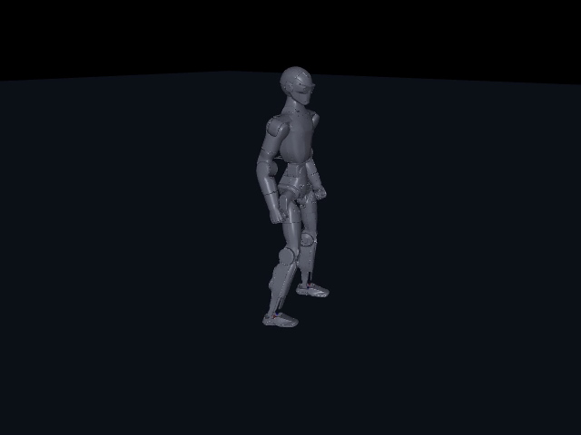
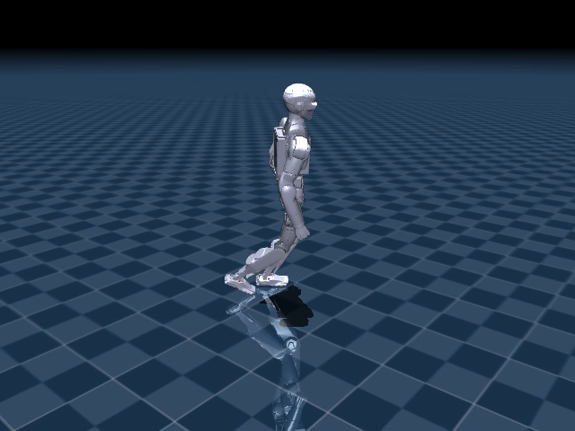
The Symptom
Same policy, same weights — two very different outcomes (click each clip to play)
Training sim (plain MuJoCo) — full 12s, straight, clean
Deployment sim (unitree_mujoco, real DDS) — walks, then falls at ~2.8s
• Same trained network. Same weights. Same target physics model. Different result.
• The previous slide showed real, physical differences between these two environments — contact geometry, 50x different joint damping, floor friction, a real-time DDS harness with none of the training side's single-process simplicity
• Any one of those looks like a plausible explanation on its own — the obvious first hypothesis: is this the classic sim-to-sim "reality gap"?
Embodied AI — Week 20 | The Symptom

Slide 6
THEORY 1
Physics Reality Gap
The textbook hypothesis, and why it seemed obviously right
• The two simulators represent the R1 differently at the contact level:
– Training model (r1_standalone.xml): simplified CAPSULE collision shapes
– Deployment model (R1_C++.xml): full COLLISION MESHES + sphere-marker feet
• Different geometry -> different contact points, friction cones, penetration/restitution
• This is the standard "sim-to-sim reality gap" — the textbook fix taught in every RL robotics course:
– Domain Randomization (DR): randomize physics every episode so the policy is robust to a RANGE of dynamics, hoping deployment falls inside that range
• A well-motivated hypothesis — not a guess. Worth testing properly.
Embodied AI — Week 20 | Theory 1: Reality Gap

Slide 7
THEORY 1
Domain Randomization — What We Built
Parameter | Randomization Range
Friction (floor + each foot) | 0.5 – 1.4x
Body mass / inertia (per-body) | 0.90 – 1.12x
Pelvis extra mass ("payload slop") | 0.85 – 1.25x
Motor stiffness (kp) | 0.85 – 1.15x
Motor damping (kv) | 0.85 – 1.15x
Sensor noise (gyro/gravity/pos/vel) | std 0.05 / 0.02 / 0.01 / 0.15
Push perturbations | up to 0.3 m/s, every 2.5-4s
• Two training runs: walk3_dr (from scratch), walk3b (warm-started, refined)
• Randomized fresh from pristine copies every episode reset
Embodied AI — Week 20 | Theory 1: DR Implementation

Slide 8
THEORY 1
A Hyperparameter Trap Along the Way
• Pushes are for EXTERNAL-disturbance robustness — but nothing pushes the robot during a sim2sim transfer test. We didn't know that yet.
• Aggressive pushes (0.5 m/s every 1-2s):
– capped episode length at ~240 steps (~5s)
– robot kept getting knocked down before experiencing enough of the DYNAMICS randomization that should matter
• Softened to 0.3 m/s every 2.5-4s:
– episode length recovered to 500-650 steps
– but reward started THRASHING wildly: -407 to +224
– episode length actually DECLINED after 400k steps
• Diagnosis: PPO instability — single environment, high-variance DR returns, no parallel envs to average the noise out
Embodied AI — Week 20 | Theory 1: Hyperparameter Trap

Slide 9
THEORY 1 — RESULT
Negative Result
• Sim2sim survival after DR: best ~3.5s, typical 1-2s
– NO reliable improvement over the 2.85s pre-DR baseline
• DR did not damage the underlying gait either — same checkpoint still walked 20s / 5.75m cleanly in PLAIN MuJoCo
•
• Two specific physical culprits chased inside this theory — both RULED OUT:
– Mass/inertia mismatch — checked body-by-body: training XML and unitree scene XML are mass-identical (28.93 kg). Not the cause.
– "Floppy torso" — channel 14 (waist_pitch) is force-zeroed in deployment (a phantom DDS channel), so the heavy torso hangs uncontrolled — training has no such joint. Tested a stiff hold (kp80/kd5). Did NOT help.
Buried discovery: the SAME checkpoint measured 3.53s, 2.59s, 1.86s under near-identical settings — the laptop's real-time DDS loop is CPU-starved. Survival numbers were noisy, not trustworthy.
Embodied AI — Week 20 | Theory 1: Result

Slide 10
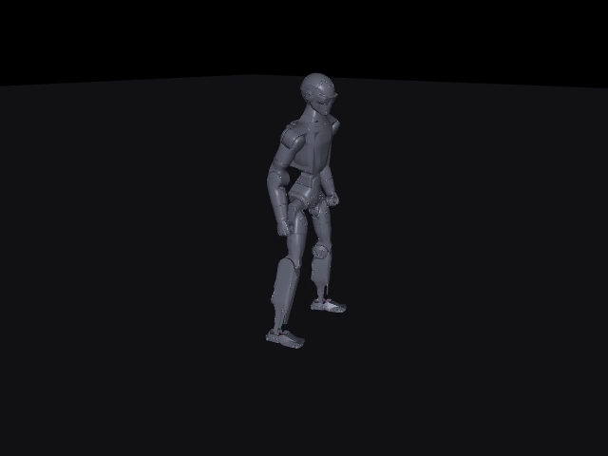
THE BREAKTHROUGH
Troubleshooting
What Theory 1's failure taught about isolating variables
• Theory 1 changed MULTIPLE things at once (many physics parameters) while measuring through a harness ALREADY KNOWN to be noisy (the buried CPU-contention discovery) — so even a real improvement couldn't be told apart from measurement noise, and physics couldn't be told apart from the harness as the true cause
• The lesson: isolate ONE variable at a time, with a measurement you can trust. Hold physics EXACTLY correct (the real deployment model) and remove the noisy real-time harness entirely — a clean batch rollout, no DDS, no async clock
20 seconds 6.3 meters ZERO falls
Full 20s, exact deployment physics, batch — click to play
• Built r1_walk_deploy_env.xml DIRECTLY from R1_C++.xml (exact deployment model), ran the SAME policy in a clean batch rollout
• This ONE isolated experiment eliminates physics entirely as the cause. Whatever kills the robot lives ONLY in the real-time deployment harness — the one thing this test didn't include.
Embodied AI — Week 20 | Troubleshooting

Slide 11
ROOT CAUSE — PROOF
Reproducing the Fall on Command
Injecting artificial control delay into the SAME clean batch rollout
• 2-step (40ms) injected delay EXACTLY matches the 2.7s fall observed in real unitree_mujoco
• The DDS round-trip (lowstate -> policy -> lowcmd -> bridge -> physics, across two async 500Hz loops) IS ~1-3 steps of real latency
• This is not a coincidence — it is the mechanism, reproduced synthetically
Embodied AI — Week 20 | Root Cause: Proof

Slide 12
ROOT CAUSE — MEASUREMENT
What's Actually Happening in the Real Harness
• Measured DDS obs staleness directly: mean 0.7ms, max 2.8ms (<1.5 physics steps) — average latency is TINY
• But: the sim and controller are two FREE-RUNNING 500Hz loops sharing one laptop CPU
– Sim only manages ~75% real-time (10 sim-sec takes 13.3s wall, ~67% CPU)
– The two async loops DESYNC — publish-dt occasionally SPIKES to 20ms = a 10-step stall
• Trajectory logs confirm: the robot walks FINE for ~0.9s, then progressively topples after a spike — chaotic divergence, not a spawn or observation bug
• So the harness isn't uniformly slow — it's USUALLY fine, with occasional scheduling spikes the fragile gait can't absorb
Embodied AI — Week 20 | Root Cause: Measurement

Slide 13
ROOT CAUSE
The fall is TWO factors multiplied together:
1. The real-time DDS harness delivers occasional 20-40ms control stalls
2. The trained gait has near-zero stability margin — small, low, shuffling steps, no push recovery
Neither alone fails: a robust gait shrugs off the spikes; a spike-free harness lets even this fragile gait walk 20s.
Why the gait is fragile: reward penalizes torque, action-rate, and acceleration -> PPO found the laziest gait that scores -> tiny, low, shuffling steps, zero margin ("minimum leg raises" in the training video is the visual signature of the same fact that causes the crash).
Embodied AI — Week 20 | Root Cause

Slide 14
Fixes Attempted
Fix | Approach | Result
Lockstep harness | Deterministic 1-cmd-per-step handshake, still real DDS | 2-3x survival (2.4s -> 5.8s). Real, partial fix.
Fixed-latency training | Retrain with 0-4 step delay randomization | Worse on real harness — real jitter isn't a fixed delay
Durable fix (planned) | Robust gait: bigger steps, stability-margin reward, VARIABLE-latency training, on lab RTX 5080 (parallel envs) | Not yet run — laptop single-env throughput is the blocker
• Lesson from fixed-latency training: train against the ACTUAL disturbance distribution, not an idealization of it
• Lockstep proves the timing-spike theory is real — it just isn't the whole story (a zero-margin gait also amplifies float-level model differences no harness can hide)
Embodied AI — Week 20 | Fixes Attempted

Slide 15
Lessons Learned
• Always isolate model-gap vs. harness-gap with a clean batch rollout on the deployment model BEFORE blaming "the reality gap"
• A negative result (DR didn't work) is not wasted effort — it eliminated the wrong hypothesis and forced the right question
• Reward-engineered gaits optimize for the metric, not for robustness — small/low/shuffling steps score well but have zero margin for disturbance
• Single measurements are unreliable under CPU contention — verify survival numbers with multiple clean rollouts before trusting them
• This IS a sim2real-relevant finding: real robots have real control latency. A gait that can't survive 40ms in simulation would not survive hardware either.
Embodied AI — Week 20 | Lessons Learned

Slide 16
Next Steps
• Move training to the lab RTX 5080 box (AAI-Lab-1) for real throughput — parallel envs (SubprocVecEnv) or GPU physics (MJX / Isaac)
• Train a genuinely robust gait: foot-clearance / stability-margin reward, bigger steps, VARIABLE (not fixed) latency randomization
• Re-verify: clean isolated batch rollout + real unitree_mujoco DDS test, multiple rollouts per checkpoint
• Longer-term: path toward the physical R1 (sim2real) — a latency-robust gait is a prerequisite, not a nice-to-have
Embodied AI — Week 20 | Next Steps

Slide 17
Questions
Demo videos + full diagnosis: ~/r1_walk/demo/ (SIM2SIM_DIAGNOSIS.md)

